Slide 1
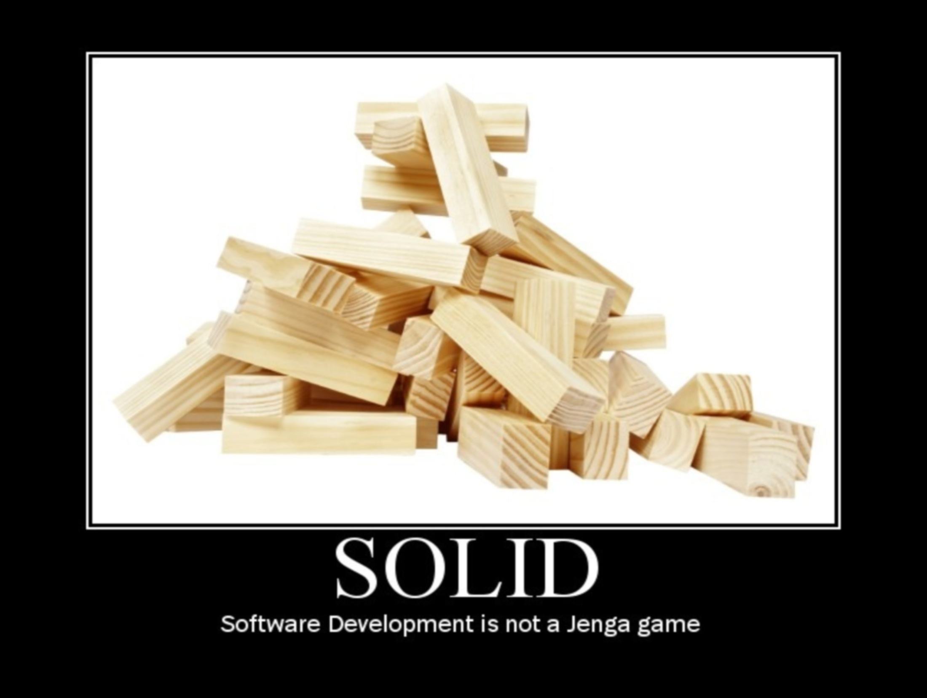

Slide 2
Contents
Introduction to “Uncle Bob’s Principles of OOD” and what they address
The Single Responsibility Principle
Exercise: Refactoring to SRP

Slide 3
What’s the problem?
Symptoms of poor design
Code is difficult to change
Code is brittle
Difficult to re-use
Far easier to do the wrong thing than the right thing
People are scared to touch it
No fun

Slide 4
Background
Object Oriented Design is polymorphism, inheritance and encapsulation right?
‘Uncle’ Bob Martin chose the principles he considered the most important to good OOD and called them the S.O.L.I.D principles

Slide 5
SOLID
Single Responsibility Principle (SRP)
‘A class should have one, and only one, reason to change.’
Open Closed Principle (OCP)
‘You should be able to extend a classes behavior, without modifying it.’
Liskov Substitution Principle (LSP)
‘Derived classes must be substitutable for their base classes.’
Interface Segregation Principle (ISP)
‘Make fine grained interfaces that are client specific.’
Dependency Inversion Principle
‘Depend on abstractions, not on concretions.’

Slide 6
Packaging
REP: The Release Reuse Equivalency Principle
‘The granule of reuse is the granule of release.’
CCP: The Common Closure Principle
‘Classes that change together are packaged together.’
CRP: The Common Reuse Principle
‘Classes that are used together are packaged together.’
ADP: The Acyclic Dependencies Principle
‘The dependency graph of packages must have no cycles.’
SDP: The Stable Dependencies Principle
‘Depend in the direction of stability.’
SAP: The Stable Abstractions Principle
‘Abstractness increases with stability.’

Slide 7
Principles are NOT Rules

Slide 8
It doesn’t stop at SOLID
Source: [Gamma et all, "Design Patterns: Elements of Reusable Object-Oriented Software", Addison-Wesley, 1995]
Program an Interface not an Implementation
Favor Composition Versus Inheritance
Find what varies and encapsulate it

Slide 9
Source: [Martin Fowler, Kent Beck, John Brant, Refactoring: improving the design of existing code, Addison-Wesley, 1999]
Duplicated Code
Long Method
Large Class
Long Parameter List
Divergent Change
Shotgun Surgery
Data Clumps
Primitive Obsession
Switch Statement
Parallel Inheritance Hierarchy
Lazy Class
Eliminate unuseful classes
Speculative Generality
Temporary Field
Message Chains
Middle Man
Inappropriate Intimacy
Alternative Classes with different interfaces
Incomplete Library Class
Data Class
Refused Bequest
Comments

Slide 10
Source: [Meyer, "Object Oriented Software Construction", Prentice-Hall, 1997]
Modularity
Direct Mapping
Few Interfaces
Small Interfaces
Explicit Interfaces
Information Hiding
Linguistic Modular Units
Self-Documentation Principle
Uniform-Access Principle
Open-Closed Principle
Single-Choice Principle

Slide 11
Source: [Raymond, "Art of Unix Programming", Addison-Wesley, 2003]
Rule of Modularity: Write simple parts connected by clean interfaces
Rule of Clarity: Clarity is better than cleverness.
Rule of Composition: Design programs to be connected to other programs.
Rule of Separation: Separate policy from mechanism; separate interfaces from engines
Rule of Simplicity: Design for simplicity; add complexity only where you must
Rule of Parsimony: Write a big program only when it is clear by demonstration that nothing else will do
Rule of Transparency: Design for visibility to make inspection and debugging easier
Rule of Robustness: Robustness is the child of transparency and simplicity
Rule of Representation: Fold knowledge into data so program logic can be stupid and robust
Rule of Least Surprise: In interface design, always do the least surprising thing
Rule of Silence: When a program has nothing surprising to say, it should say nothing
Rule of Repair: When you must fail, fail noisily and as soon as possible
Rule of Economy: Programmer time is expensive; conserve it in preference to machine time
Rule of Generation: Avoid hand-hacking; write programs to write programs when you can
Rule of Optimization: Prototype before polishing. Get it working before you optimize it
Rule of Diversity: Distrust all claims for “one true way”
Rule of Extensibility: Design for the future, because it will be here sooner than you think

Slide 12
Source: [Parnas, "On the Criteria To Be Used in Decomposing Systems into Modules", Commununication of ACM, 1972]
Information Hiding
Modularity
Source: [Lieberherr,Holland, “Assuring Good Style for Object-Oriented Programs”, IEEE Software, September 1989]
Law of Demeter

Slide 13
Source: [Hunt, Thomas, “The Pragmatic Programmer: From Journeyman to Master”, Addison-Wesley, 1999]
DRY – Don’t Repeat yourself
Make it easy to reuse
Design for Orthogonality
Eliminate effects between unrelated things
Program close to the problem domain
Minimize Coupling between Modules
Design Using Services
Always Design for Concurrency
Abstractions Live Longer than details

Slide 14
Source: [Larman, “Applying UML and Patterns : An Introduction to Object-Oriented Analysis and Design and Iterative Development”, Prentice-Hall, 2004]
Design principles are codified in the GRASP Pattern
GRASP (Pattern of General Principles in Assigning Responsibilities)
Assign a responsibility to the information expert
Assign a responsibility so that coupling remains low
Assign a responsibility so that cohesion remains high
Assign responsibilities using polymorphic operations
Assign a highly cohesive set of responsibilities to an artificial class that does not represent anything in the problem domain (when you want to maintain low coupling and high cohesion)
Don’t talk to strangers (Law of Demeter)

Slide 15
Source: [R. Martin, “Agile Software Development, Principles, Patterns, and Practices”, Prentice-Hall, 2002]
Reuse/Release Equivalency Principle
Common Closure Principle
Common Reuse Principle
Acyclic Dependencies Principle
Stable Dependencies Principle
Stable Abstraction Principle

